Slide 2
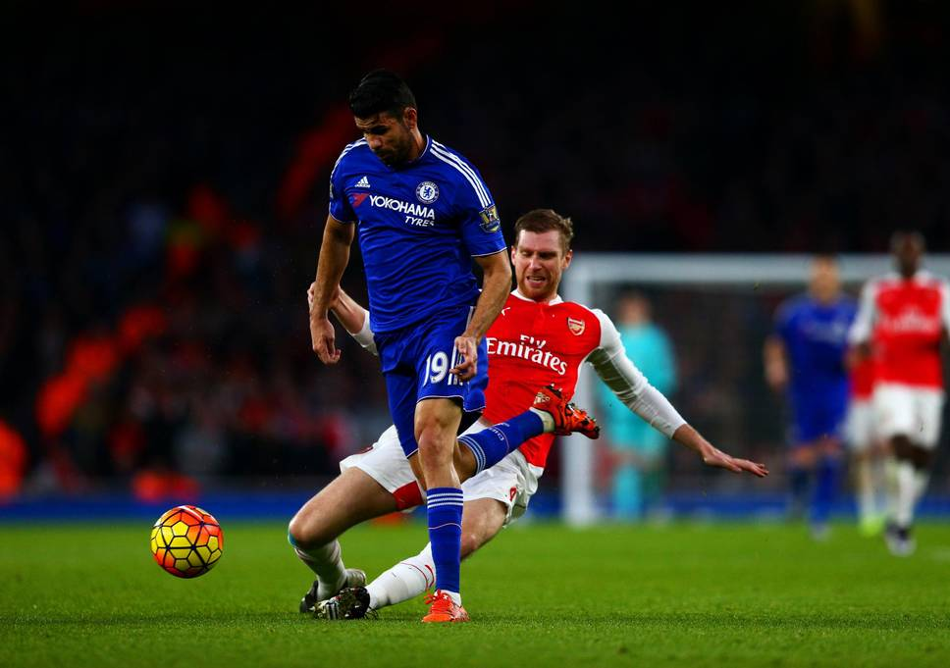
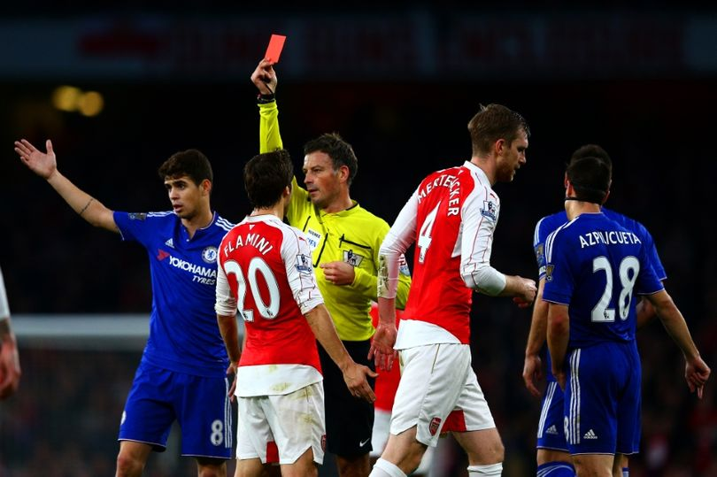

Slide 3
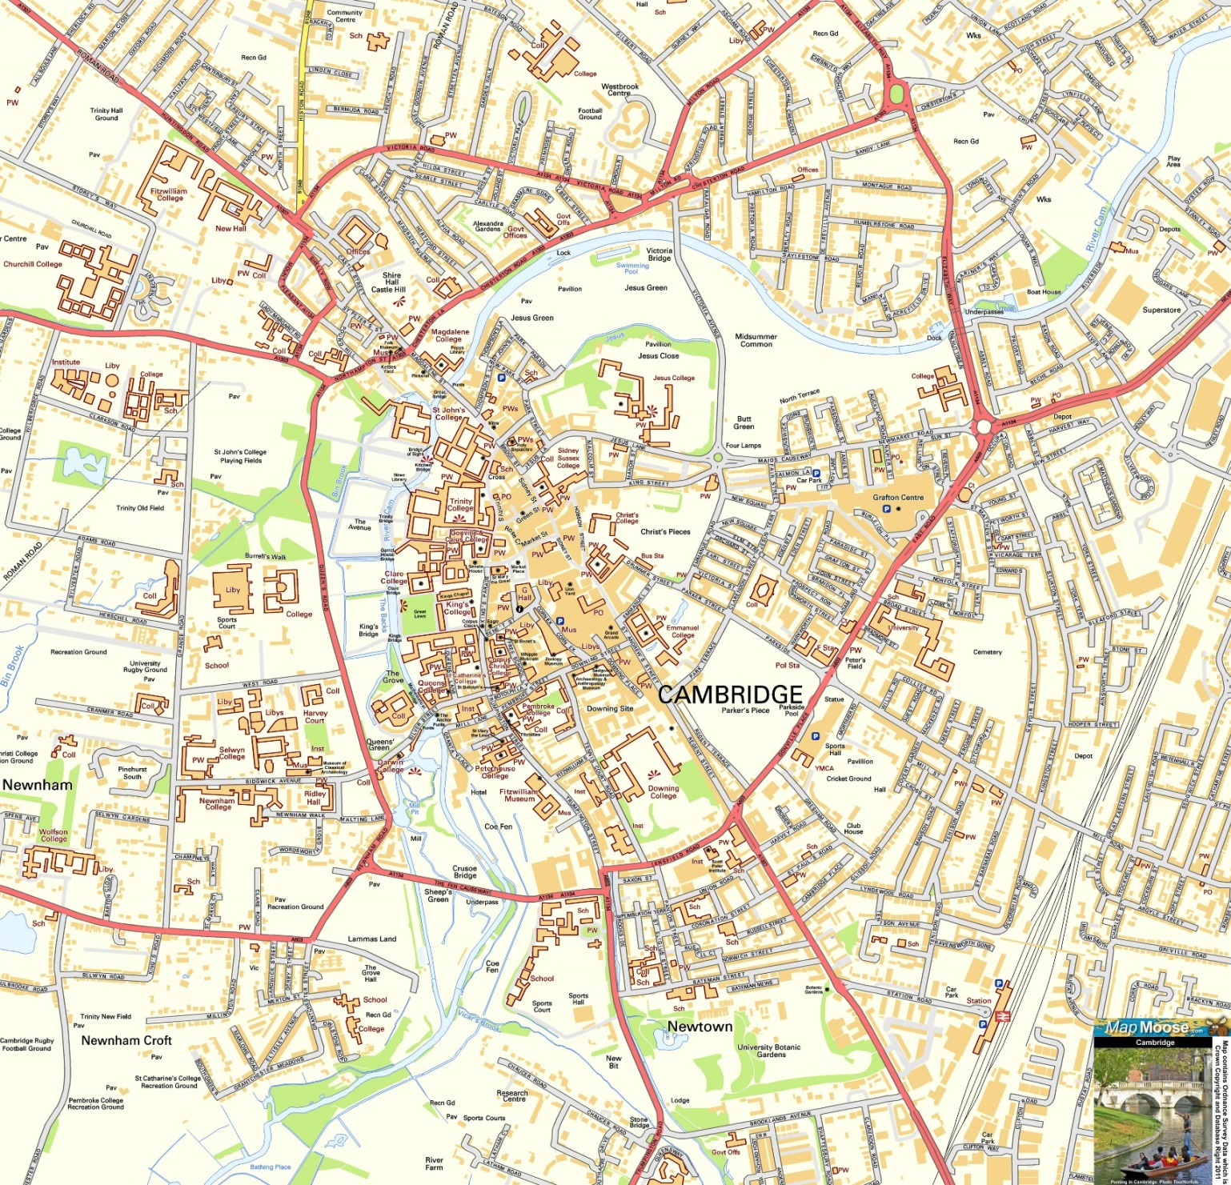
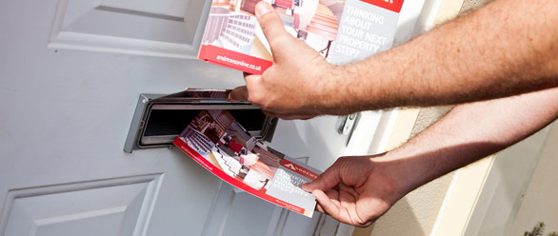

Slide 4



Slide 5
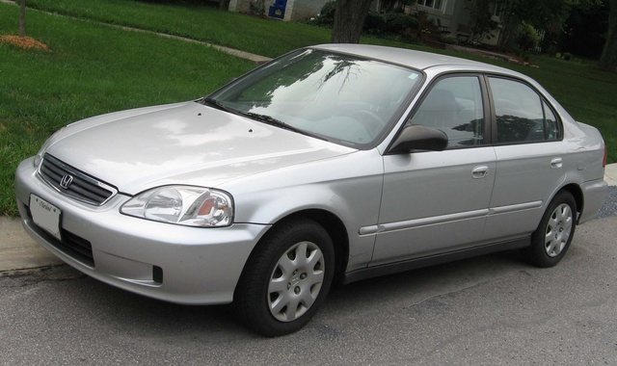
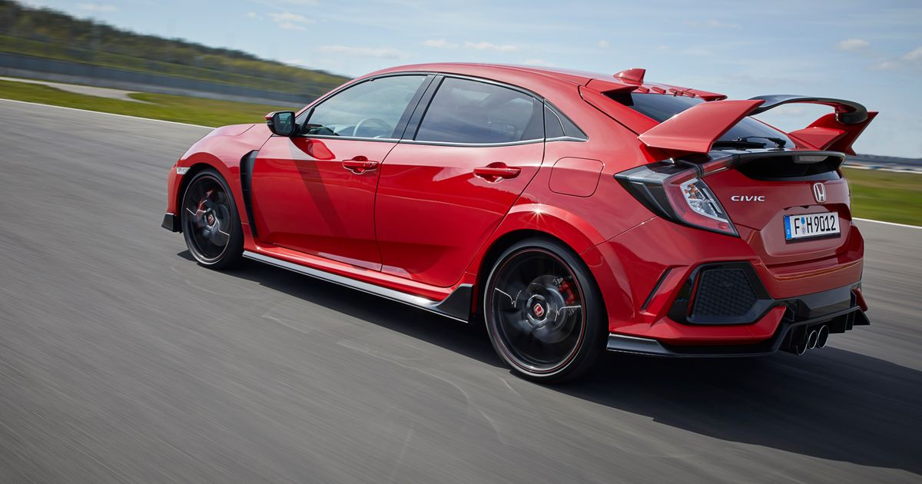

Slide 6
Midian’s
Army
Gideon’s Army
“You have too many men. I cannot deliver Midian into their hands, or Israel would boast against me, “My own strength has saved me.”

Slide 7
For it is by grace you have been saved, through faith – and this not from yourselves, it is the gift of God – not by works, so that no one can boast.”
Ephesians 2:8-9 (NIV)

